Slide 1

2015 Conference
April 10-12, 2015
Art Institute of Portland

Slide 2

Lightning Talks
Telling Stories, Building Technologies - Amelia Abreu
Work Outreach Balance - Jennifer Davidson
In '69: No Experience Necessary - Perry Eising
Agile: A Cautionary Tale - Kristin Toth Smith
Keep Yourself - Change Your Company - Dina Moy
Trans-inclusivity and Trans Women’s Tech Experience - Brook Shelly

Slide 3
Telling Stories,
Building Technologies
AMELIA ABREU
ameliaabreu.com
@ameliaabreu

Slide 4
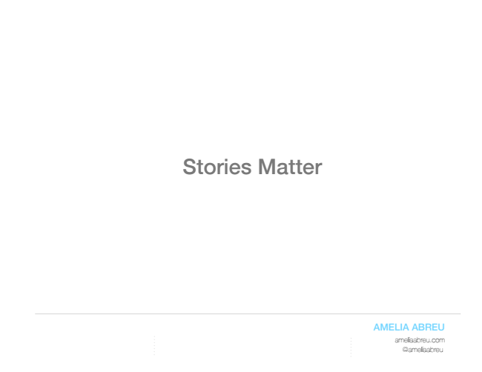

Slide 5
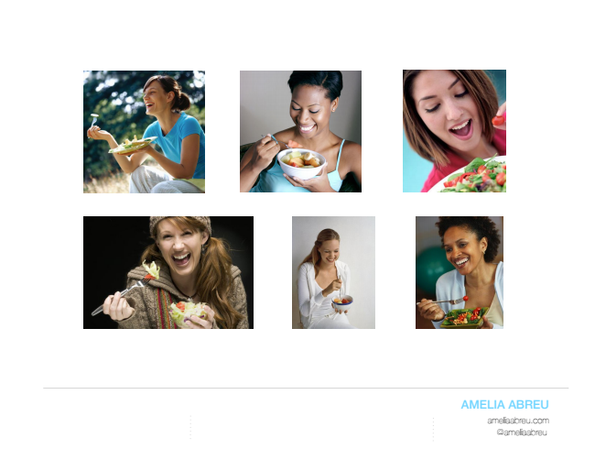

Slide 6
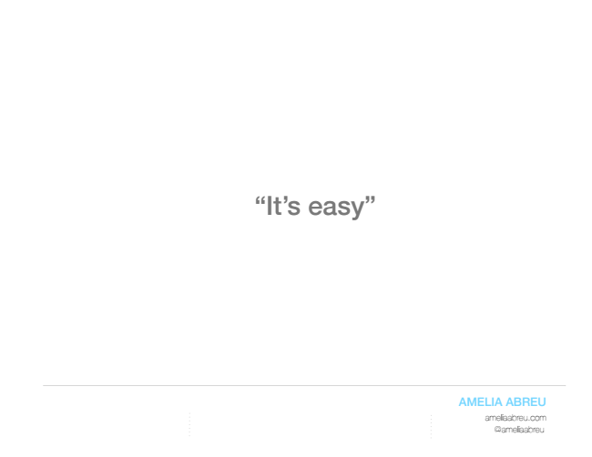

Slide 7
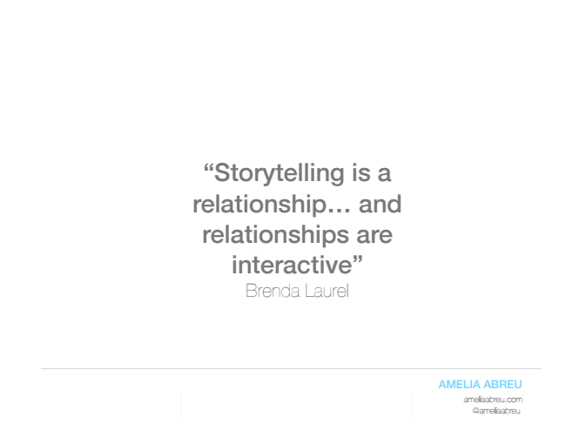

Slide 8
Work Outreach
Balance
JENNIFER DAVIDSON

Slide 9
In ‘69:
No Experience
Necessary
PERRY EISING

Slide 10
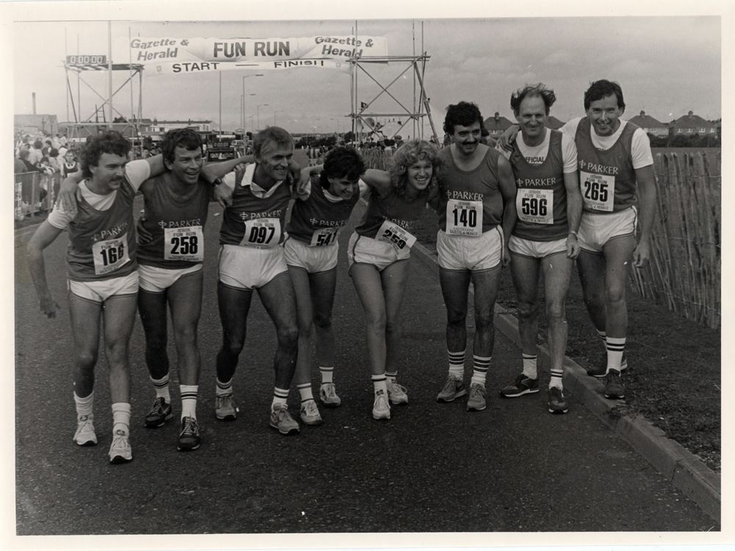
Man
Man
Man
Man
Man
Man
Man
NO EXPERIENCE NECESSARY
Catherine
Perry Eising // ACT-W Conference, Portland, Oregon 04/12/2015
Notes:
This is a finish line – th start is the topic of this talk.
In a way, running and computers are how I remember her and I how I feel connected to her.
But this talk isn’t even really about the fact that it was the sixties, or that my Mum was working in tech so long ago, or that she was a pioneer, or about feminism.
It’s about that moment in the kitchen, when she was sitting with her friend.

Slide 11
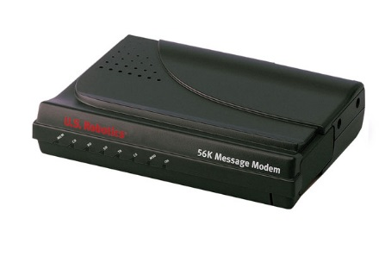
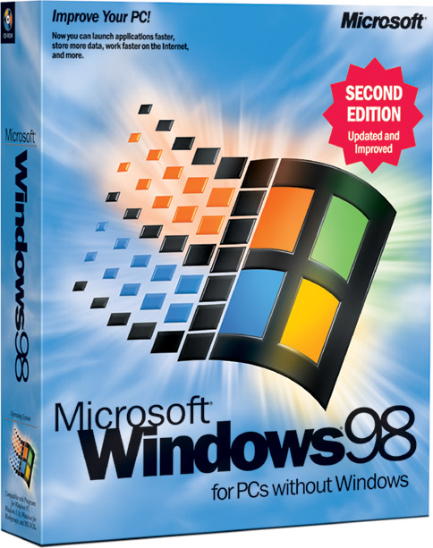
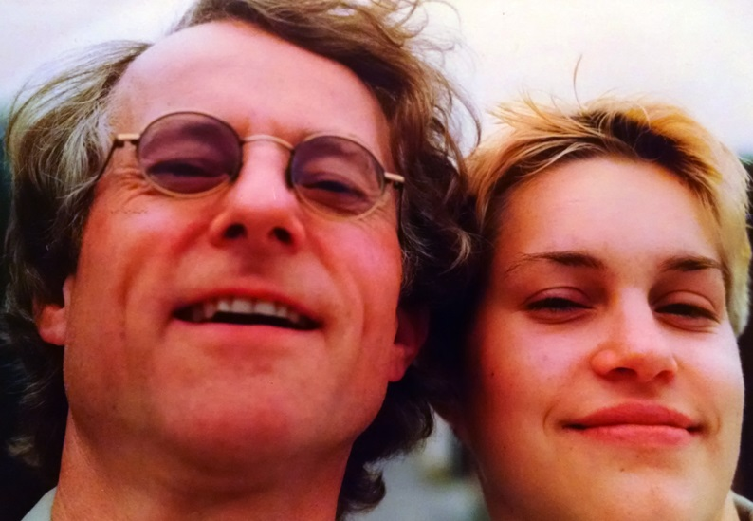

1999
Notes:
My mum and I started our careers at the same age – at 19.
Windows 98 was still a thing
56 K Dialup was standard in Germany, where I was living
NO CELLPHONES!
I was 19 and started building websites professionally, working for a startup in my city, doing front end developing and design.
But this isn’t really about me, or what technology was capable of when I first got started in tech.
It’s about what happened 30 years earlier, in 1969.

Slide 12
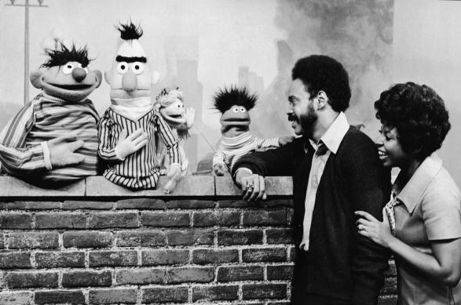
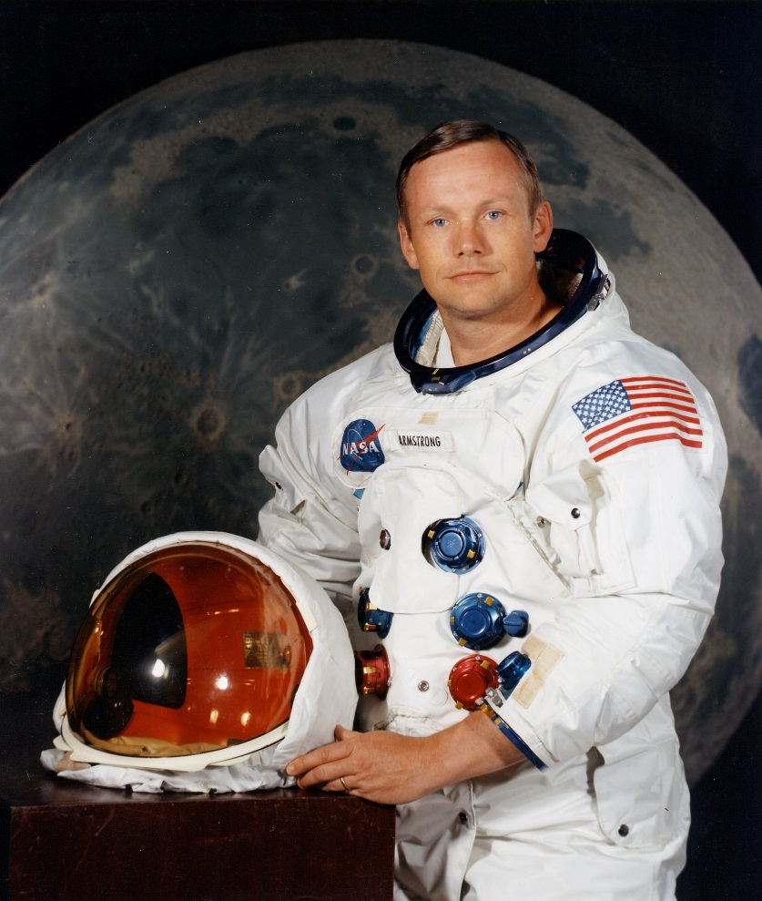
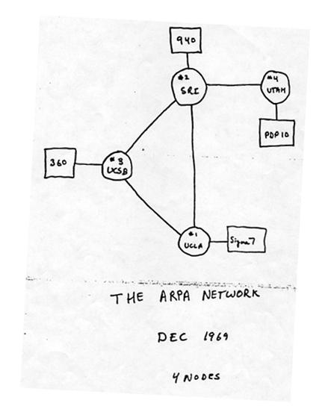
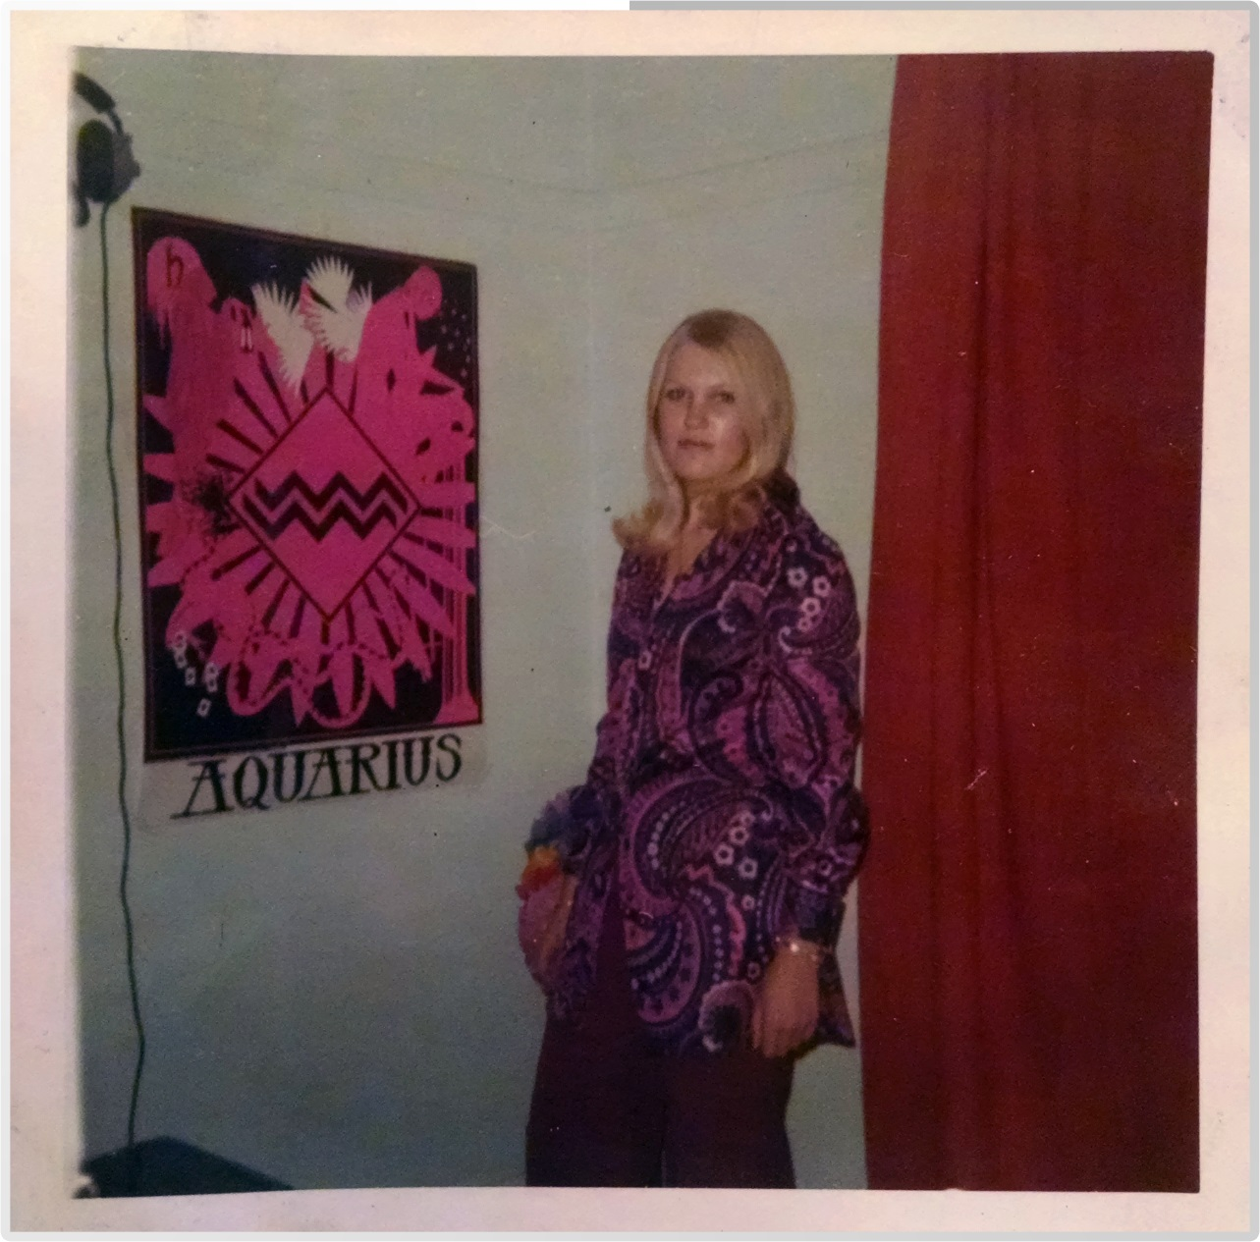
1969
Notes:
How many people here were working in 1969?
First person on the moon
Sesame Street Broadcast for 1st time
First message sent over ARPAnet
Can you tell it’s 1969?
Graduating from high school, and maybe like you, didn’t want to be a nurse or a secretary. IN Britain.
In 1969, when my mum was 19 years old and looking for a job, she sat in her kitchen with a friend sifting through the want ads, and came upon an ad that would change the future.

Slide 13
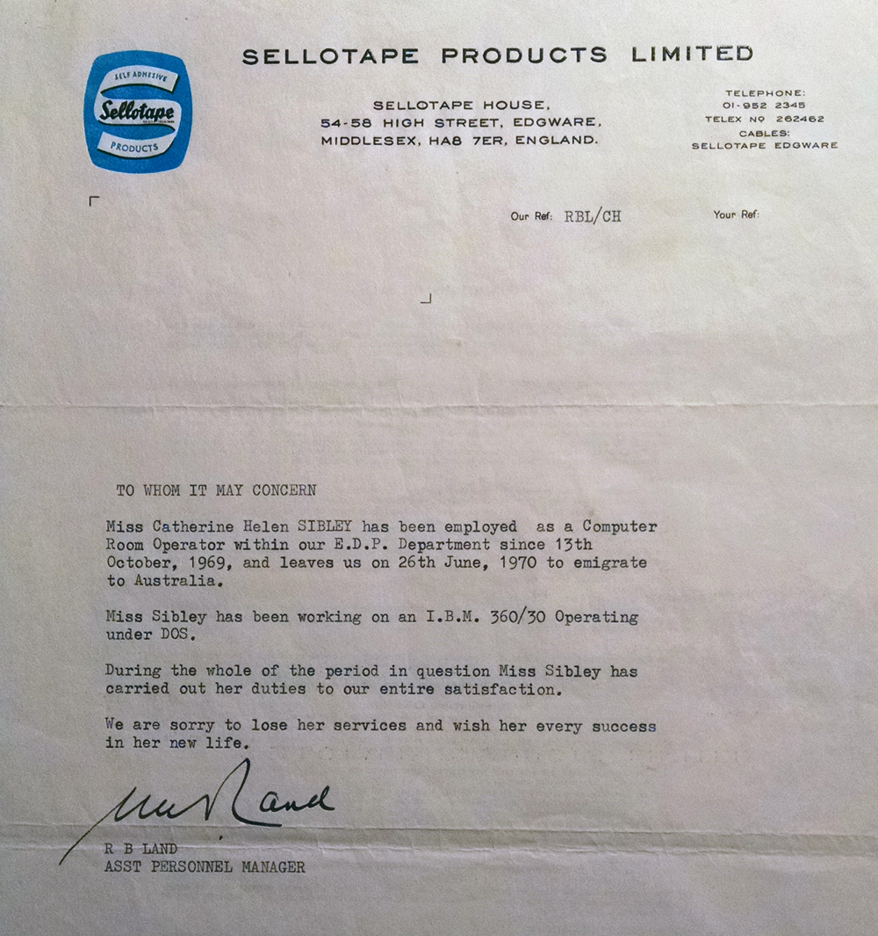
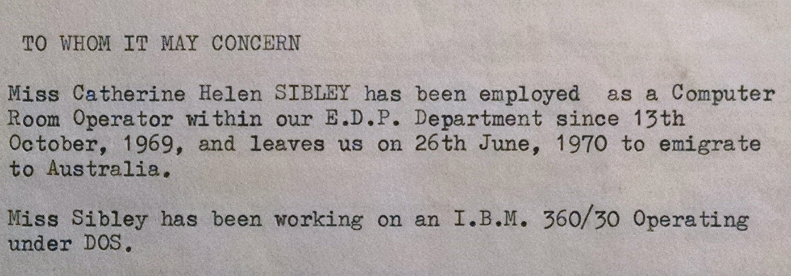
Notes:
In 1969 my mum became a computer operator, maintaining and servicing computers for the Sellotape Company – Scotch tape of britain.
Here is my mum’s official letter of reference from Sellotape products limited, in 1969.
When my mum passed away, she left a cache of documents, including her complete resume – an amazing find.
How many of you have seen an IBM 360? Raise hands!

Slide 14
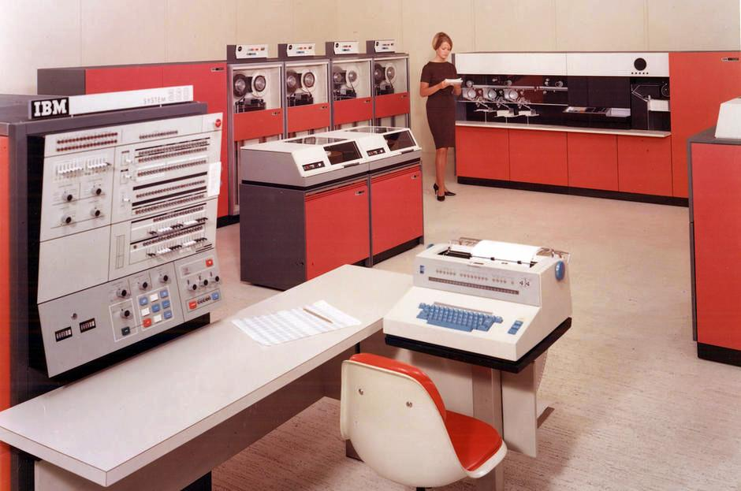
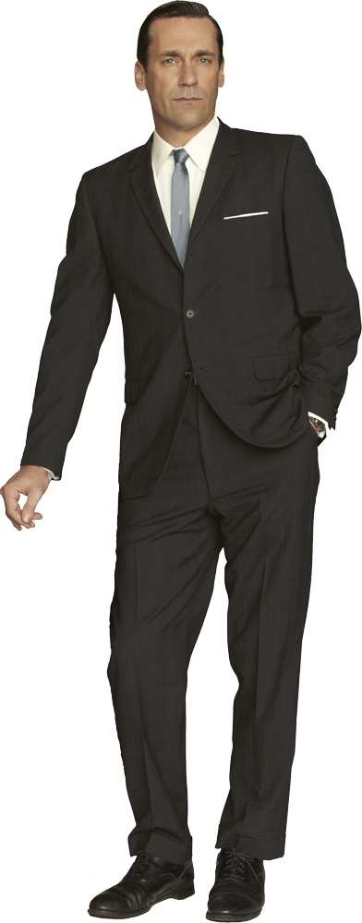
1969
Not my mum
Notes:
This, in fact, is a IBM 360/30, one of the computers my mum worked on in 1969.
It had the amazing speed of 1MhZ and anywhere from 32KB to 1 MB of RAM, which was enough, at the time, to power a whole shipping company.
As a child I was proud of the fact that my mum was in charge of maintaining the machine.
Printer Paper – debugging into the night.
Worked for Sellotape, Parker Pen, and even a small company called Industrial Business Machines – I.B.M.
All because she responded to the ad.

Slide 15
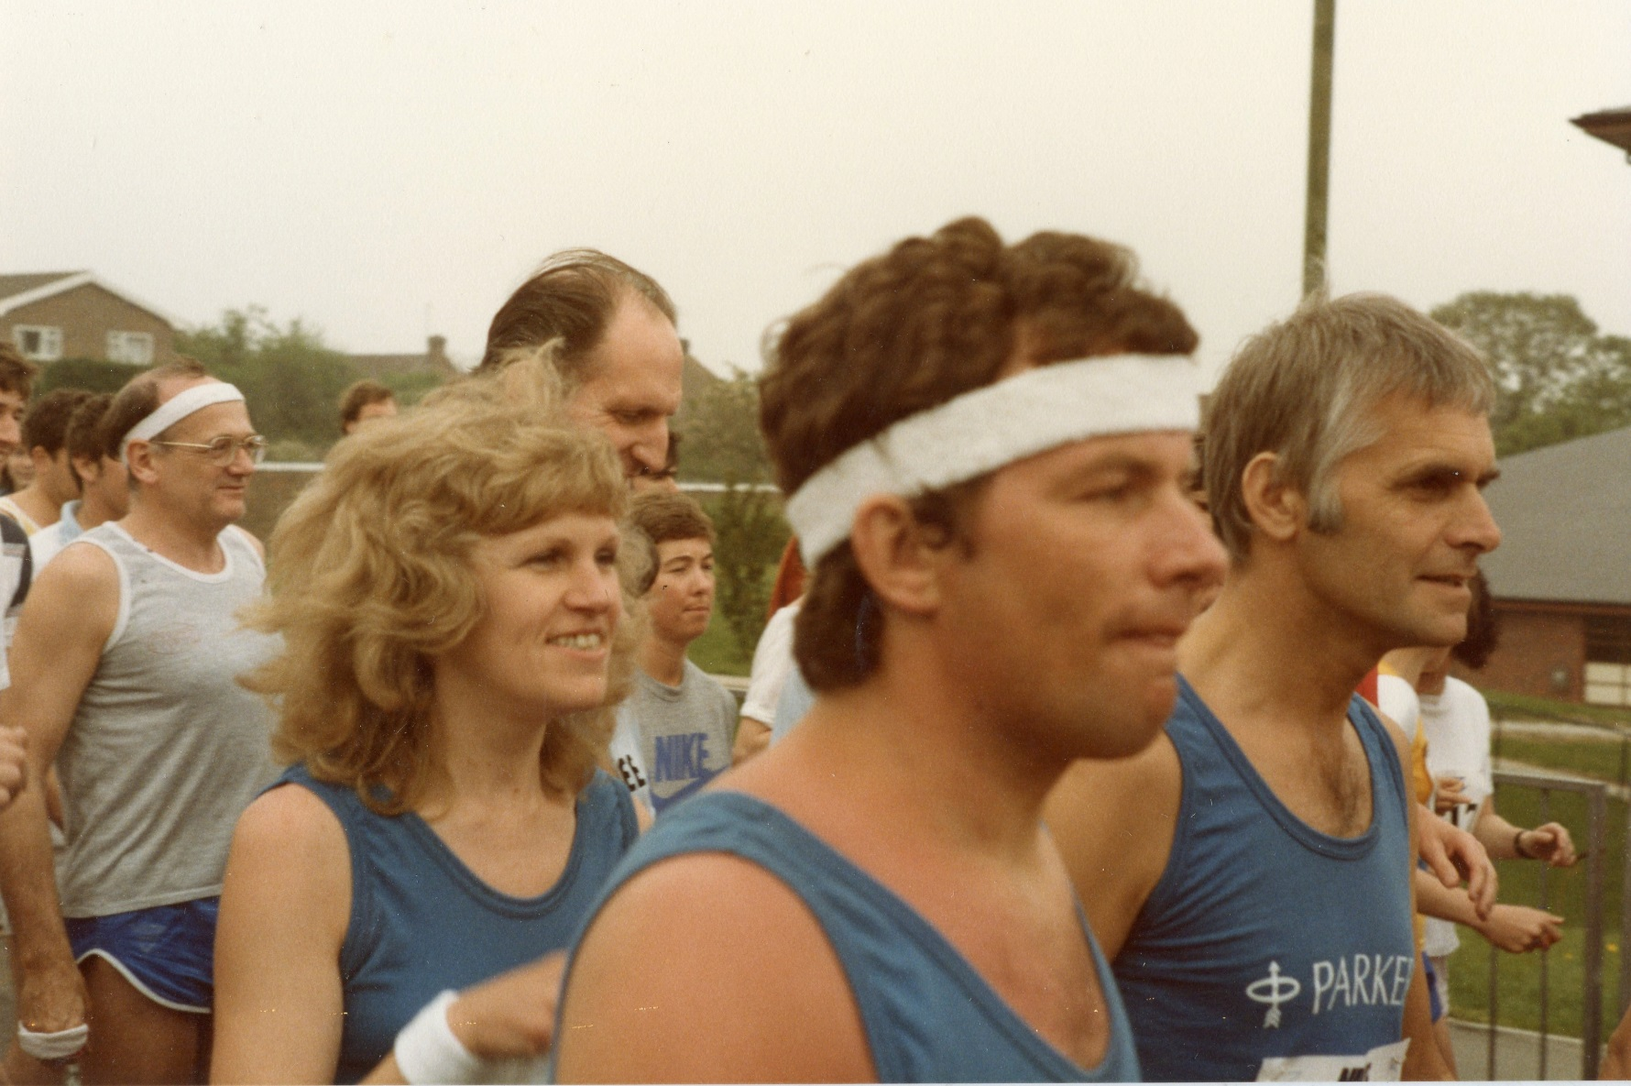
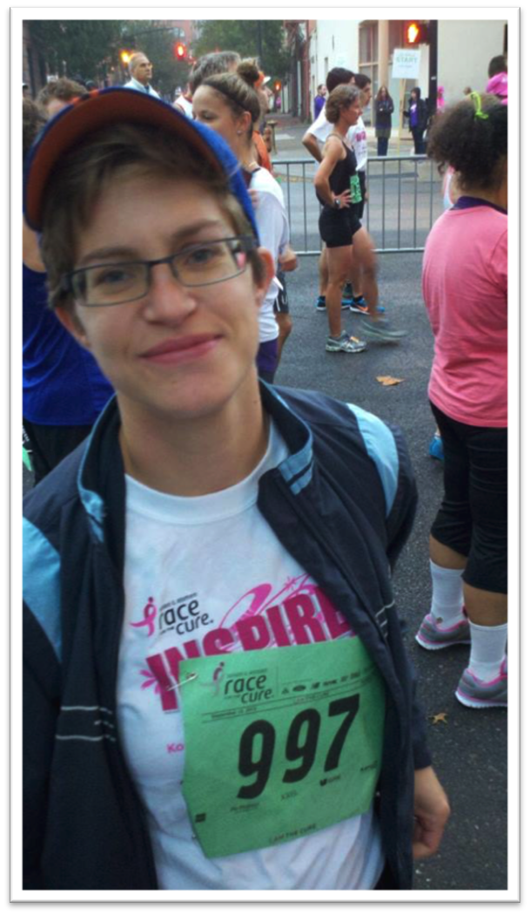
Notes:
This talk isn’t really about my mum, or about working in tech, or facing gender inequality, or about being a runner.
It’s about you can’t let the things you don’t know define who you are and what you are capable of.
It’s about how the risks you take today can define the trajectory of your life.

Slide 16
Thanks for listening! Get in touch:
Perry Eising
Twitter:@perrysetgo
Email: hello@perrysetgo.com
Notes:
You can also find me on Lanyrd under my name.

Slide 17
Agile: A Cautionary
Tale
KRISTIN TOTH SMITH

Slide 18
Keep Yourself,
Change Your Company
DINA MOY

Slide 19
